Slide 1
Story Telling with Tableau
Visual Exploration of Public Health Data
11/08/2018

Slide 2
Story a sequence of visualizations (sheets/dashboards) that work together to convey information
Why?
Tell a data narrative/explain
Provide context
Demonstrate evidence
Emphasis

Slide 3

https://public.tableau.com/profile/jnnyrchrds#!/vizhome/JennyR_CapstoneFinal_060516/Story1
Setup

Slide 4
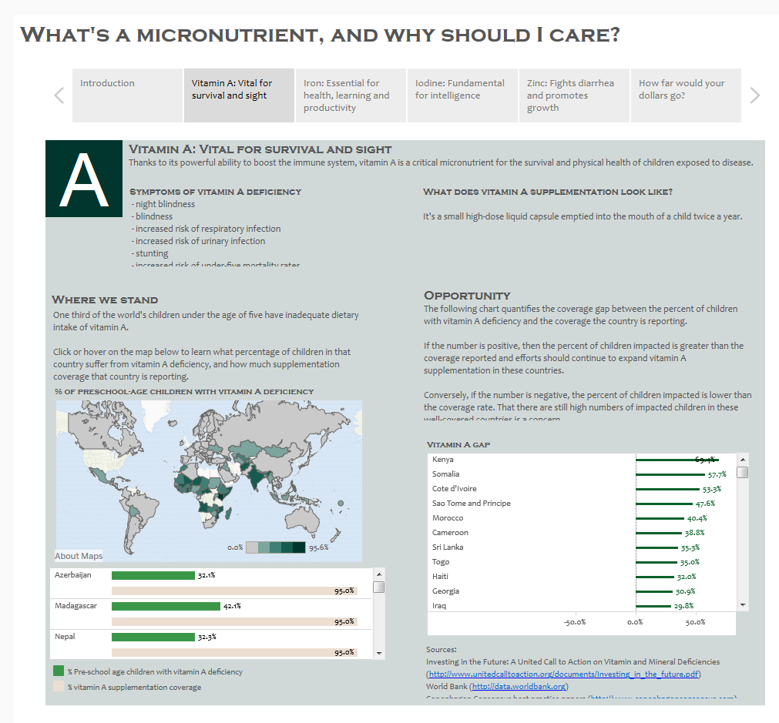
Explanation – why you should care

Slide 5
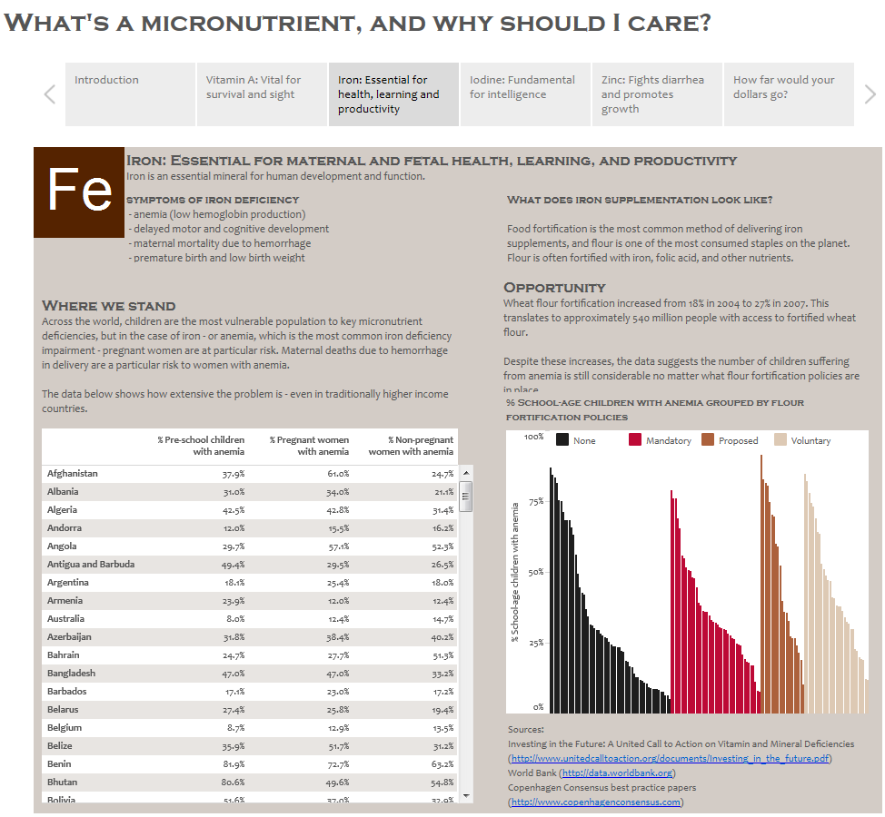
Explanation – why you should care

Slide 6
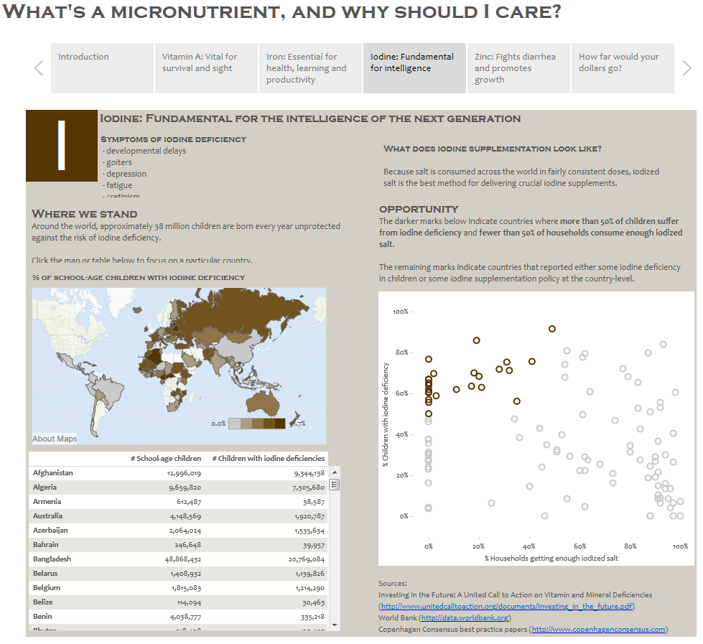
Explanation – why you should care

Slide 7
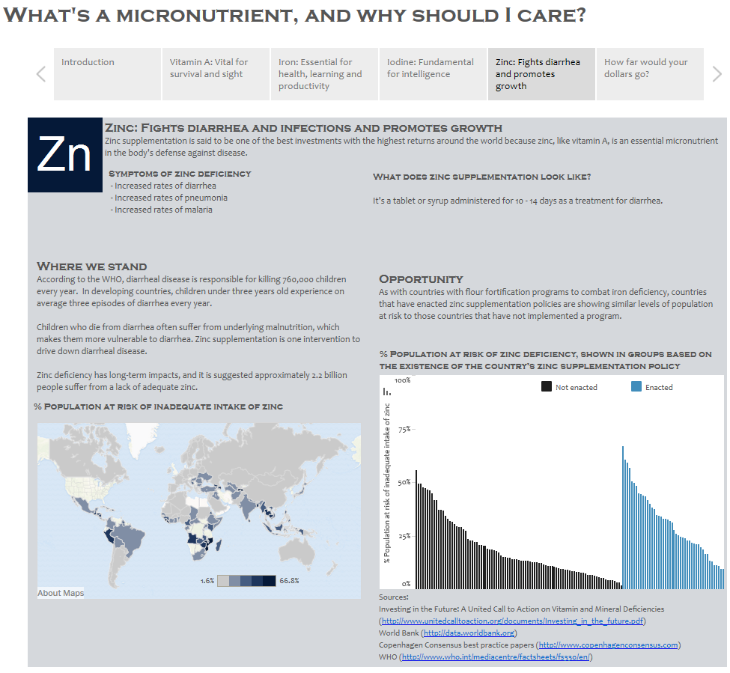
Explanation – why you should care

Slide 8
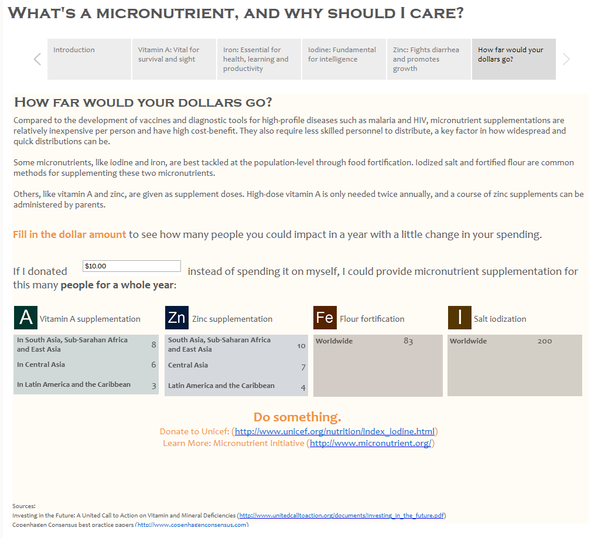
Call to Action

Slide 9
Types of stories

Slide 10

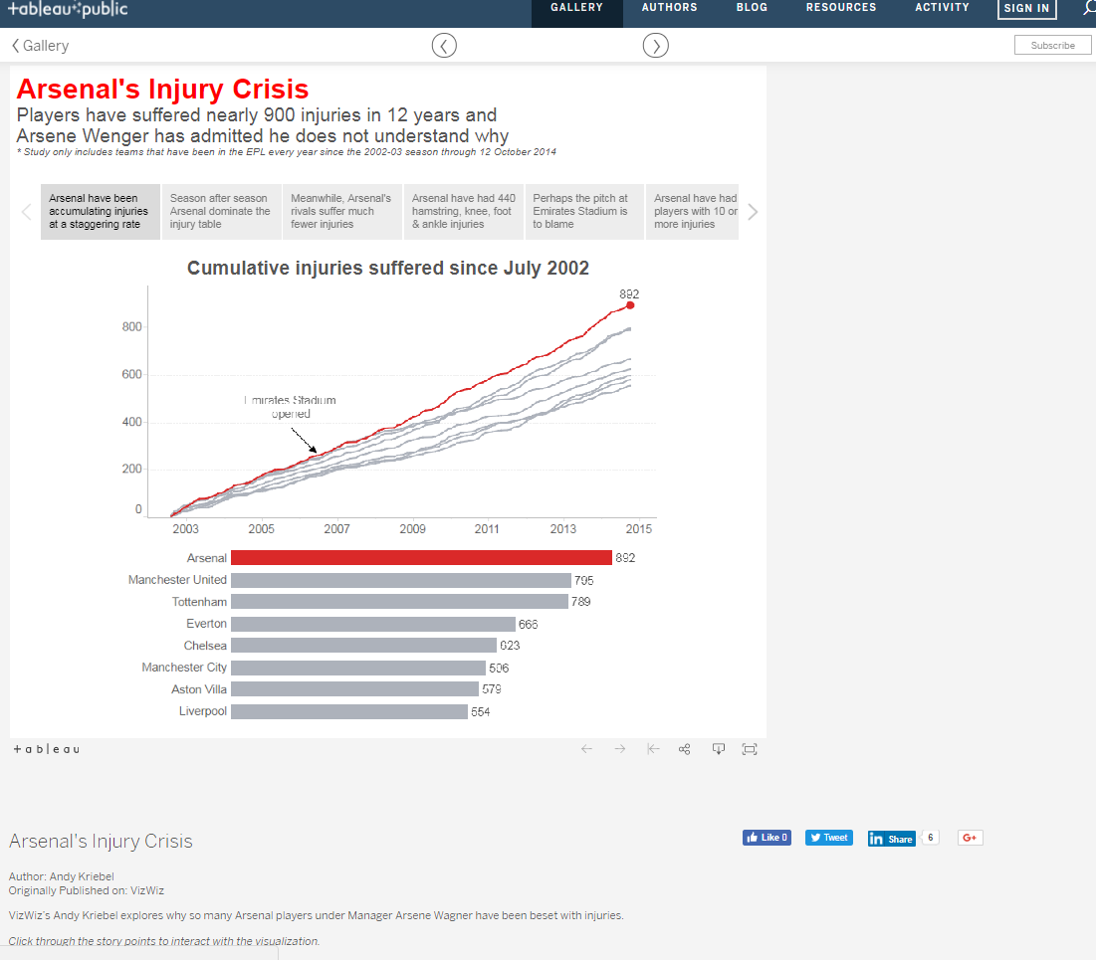
Change Over Time
What it does: Uses a chronology to illustrate a trend.
Discussions it starts: Why did this happen, or why does it keep happening? What can we do prevent or make this happen?
Example: Arsenal's Injury Crisis

Slide 11
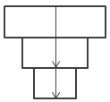
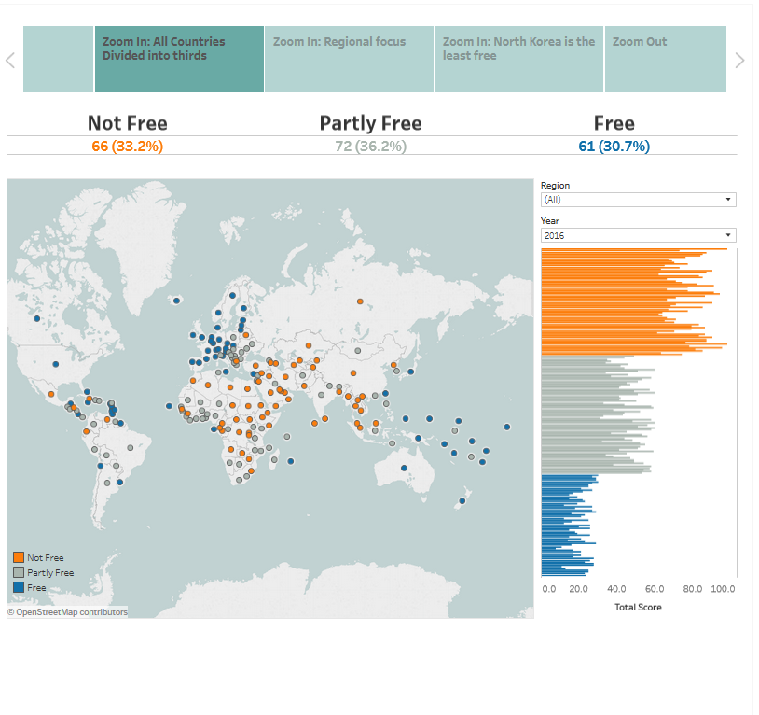
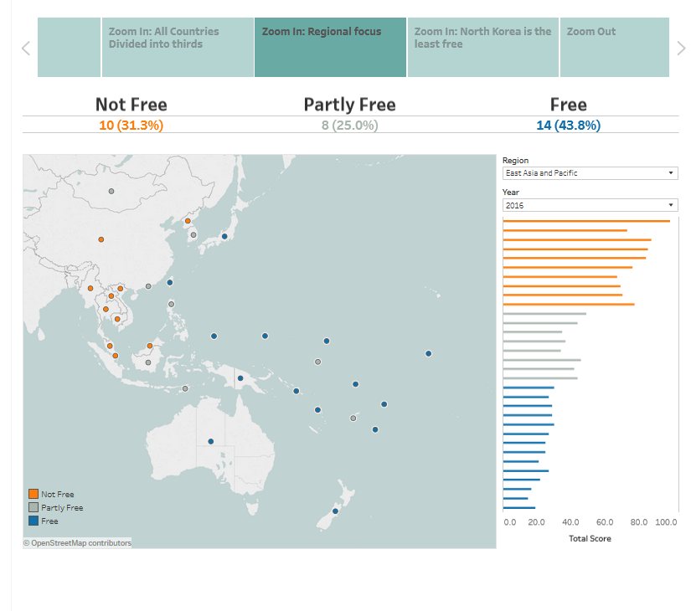
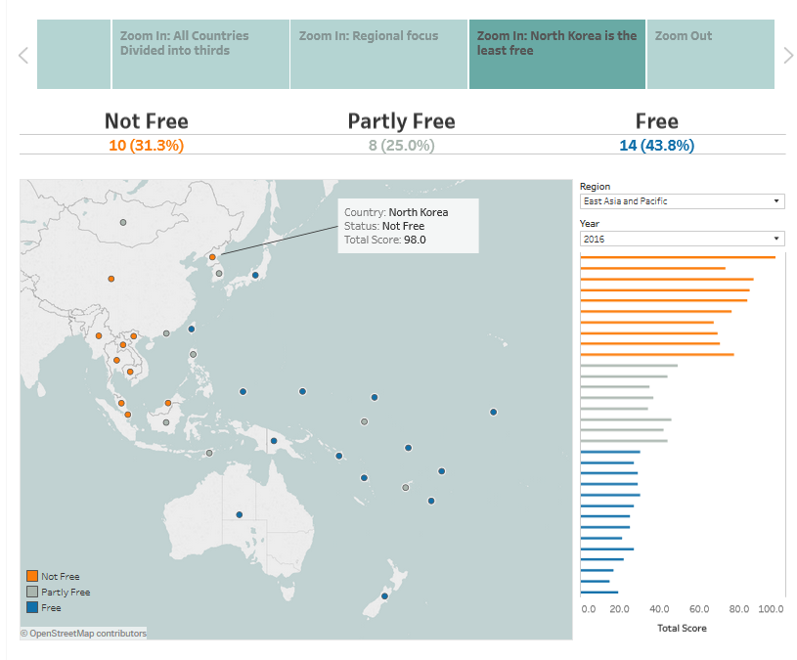
Drill Down
What it does: Sets context so that your audience better understands what's going on in a particular category.
Discussions it starts: Why is this person, place or thing different? How does the performance of this person, place, or thing compare?
Examples: Tell Me About Will, The Simpsons Vizipedia,
Data Story Free Press

Slide 12
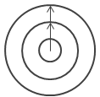

Zoom Out
What it does: Describes how something your audience cares about relates to the bigger picture.
Discussion it starts: How does something you care about compare to the bigger picture? What effect does one area have on the bigger picture?
Example: Vancouver Cyclists

Slide 13
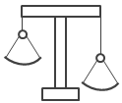
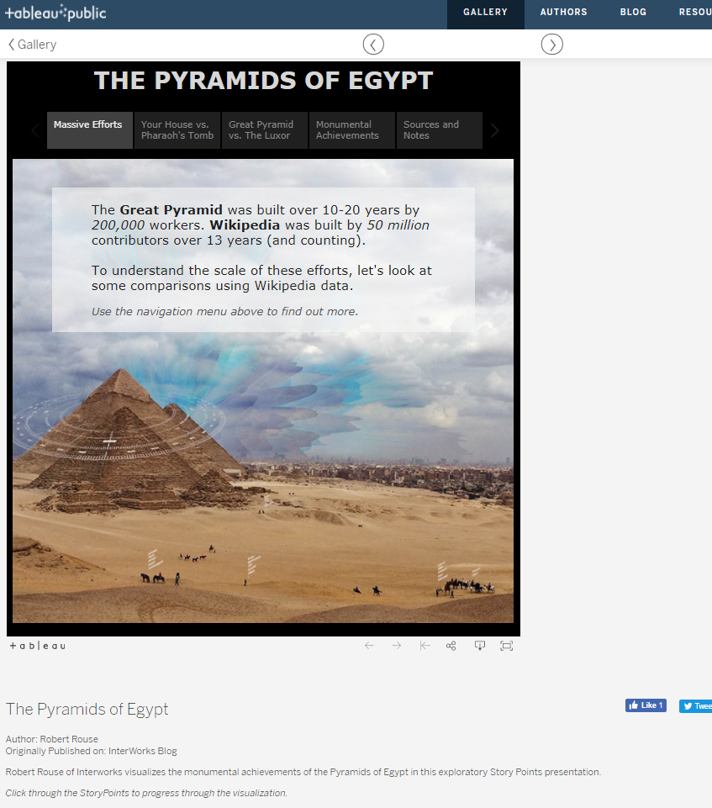
Contrast
What it does: Shows how two or more subjects differ.
Discussions it starts: Why are these items different? How can we make A perform like B? Which area should we focus on and which area is doing fine?
Example: The Pyramids of Egypt

Slide 14

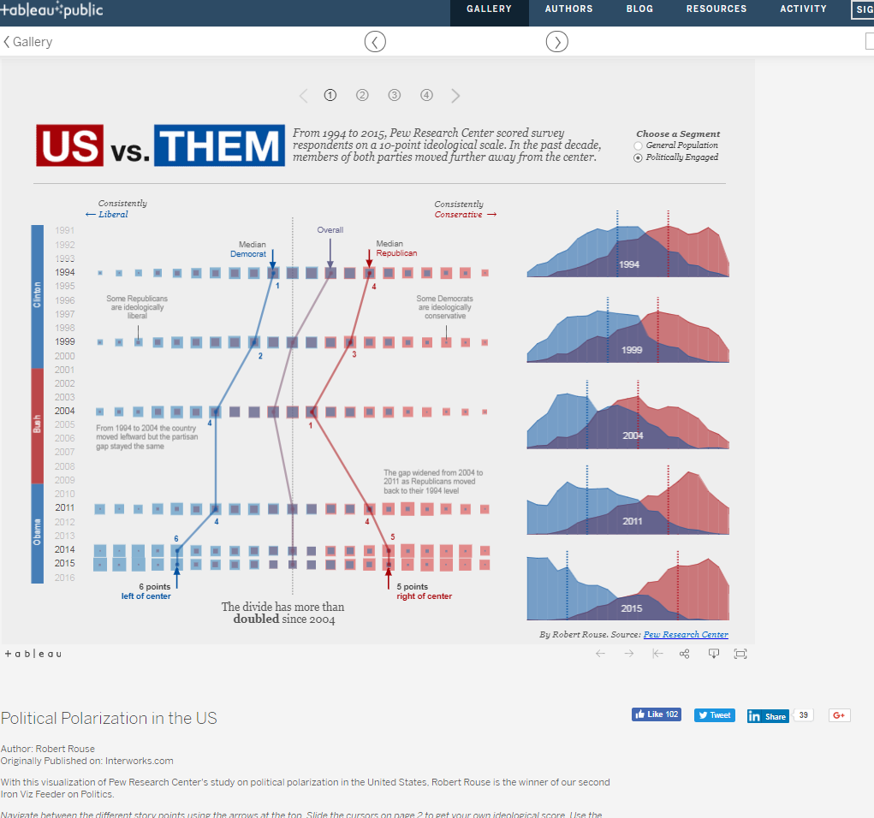
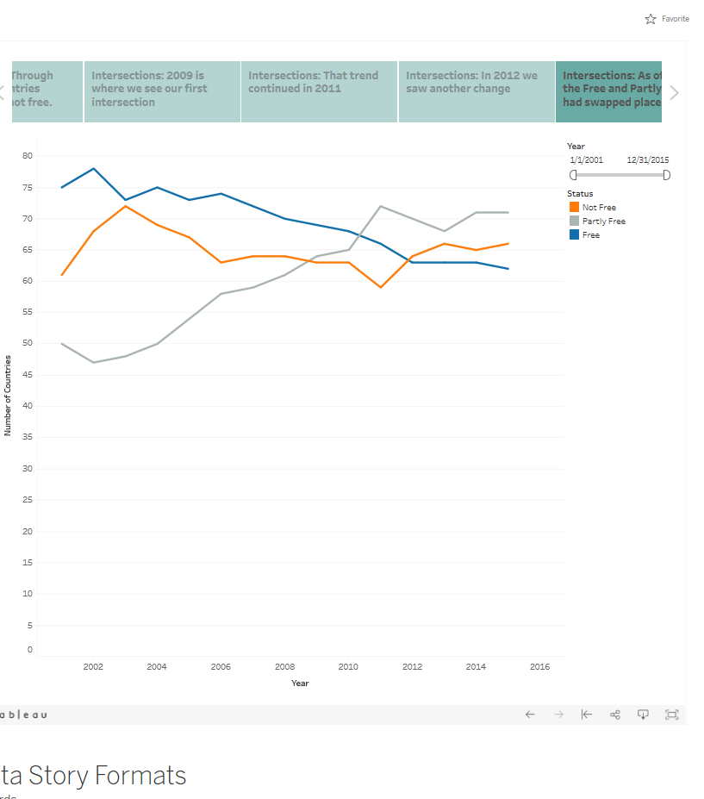
Intersections
What it does: Highlights important shifts when one category overtakes another.
Discussions it starts: What causes these shifts? Are these shifts good or bad? How do these shifts affect other aspects of our plan?
Example: US vs. THEM
Freedom of the Press dataset
https://public.tableau.com/profile/jnnyrchrds#!/vizhome/7StarterDataStoryFormats/7DataStarterStoryTypes

Slide 15
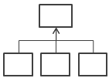
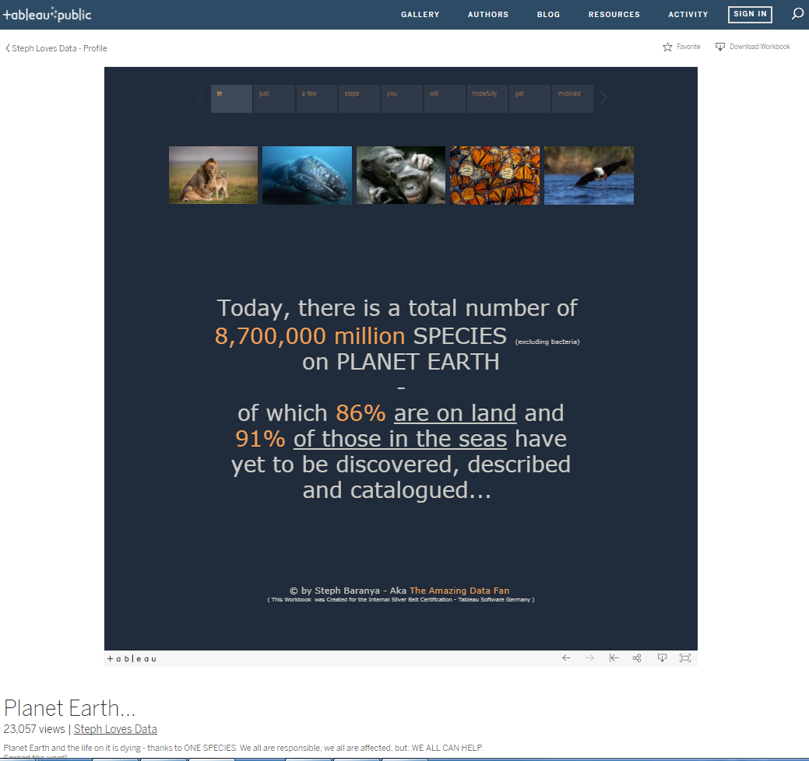
Factors
What it does: Explains a subject by dividing it into types or categories.
Discussions it starts: Is there a particular category we should focus on more? How much do these items affect the metric we care about?
Example: Planet Earth

Slide 16
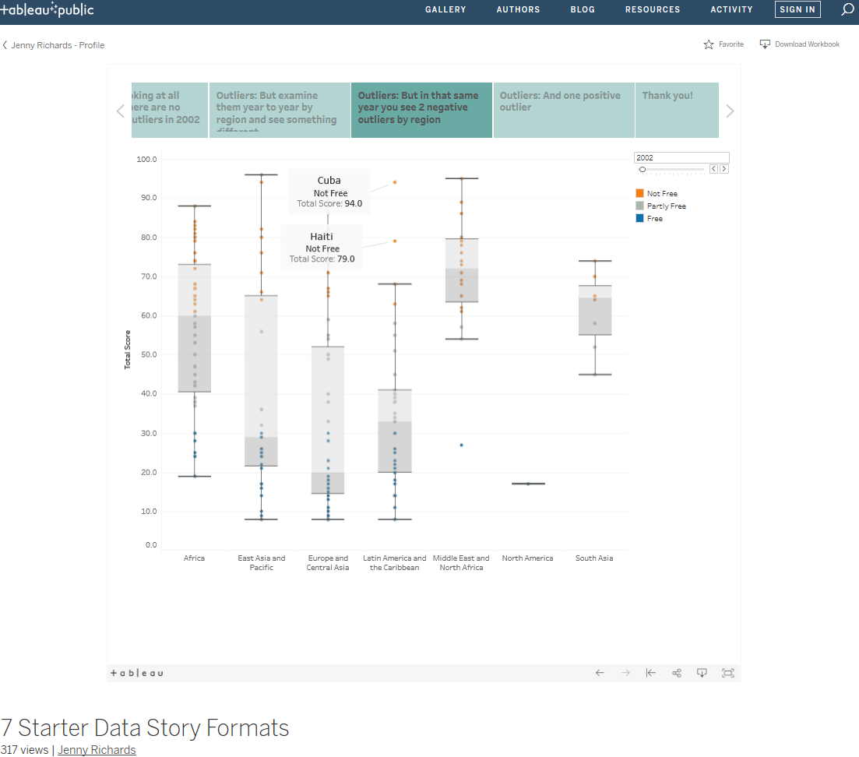
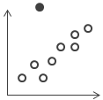
Outliers
What it does: Shows anomalies or where things are exceptionally different.
Discussions it starts: Why is this item different?
Example: SOS Children's Villages; Data Story Formats
Freedom of the Press dataset
https://public.tableau.com/profile/jnnyrchrds#!/vizhome/7StarterDataStoryFormats/7DataStarterStoryTypes

Slide 17
Other data stories to explore

Slide 18
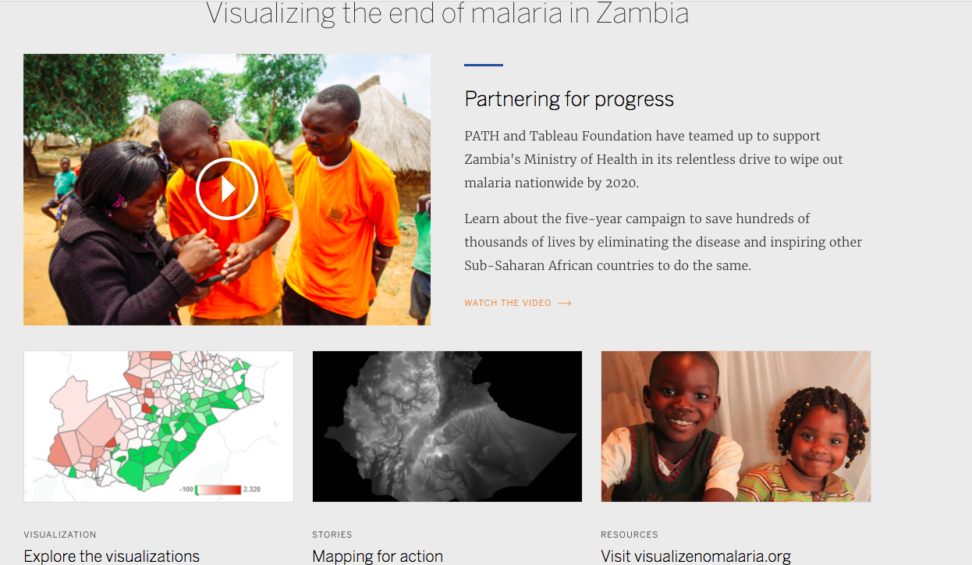
https://www.tableau.com/foundation/featured-projects/path
Story dashboard to manage malaria in Zambia

Slide 19
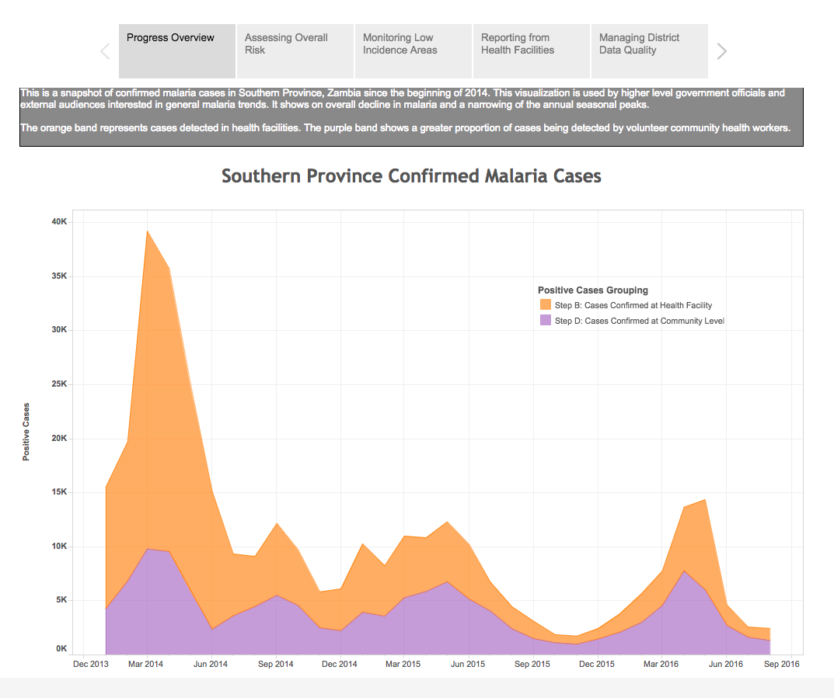
https://public.tableau.com/profile/path5412#!/vizhome/VNMStoryboard-FINAL/VNMStoryboard
Story dashboard to manage malaria in Zambia

Slide 20
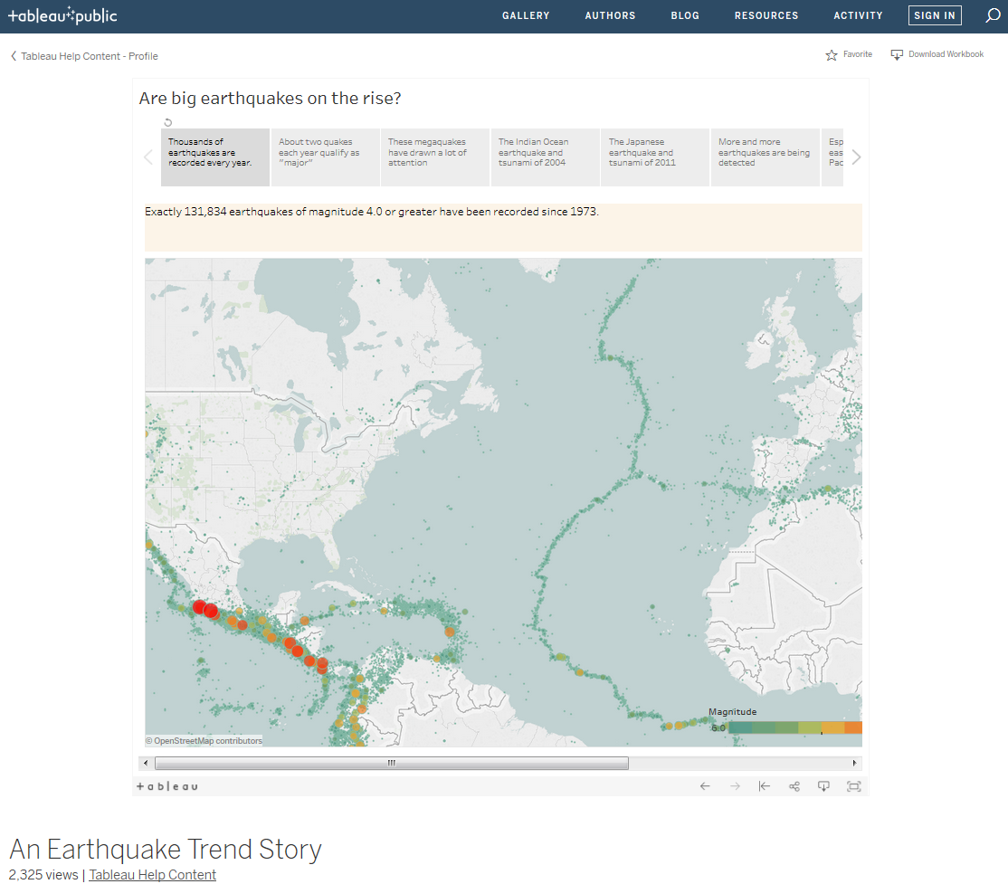
DIY Story!
http://onlinehelp.tableau.com/current/pro/desktop/en-us/story_example.html
https://public.tableau.com/profile/tableau.docs.team#!/vizhome/EarthquakeTrendStory2/Finished-Earthquakestory

Slide 21
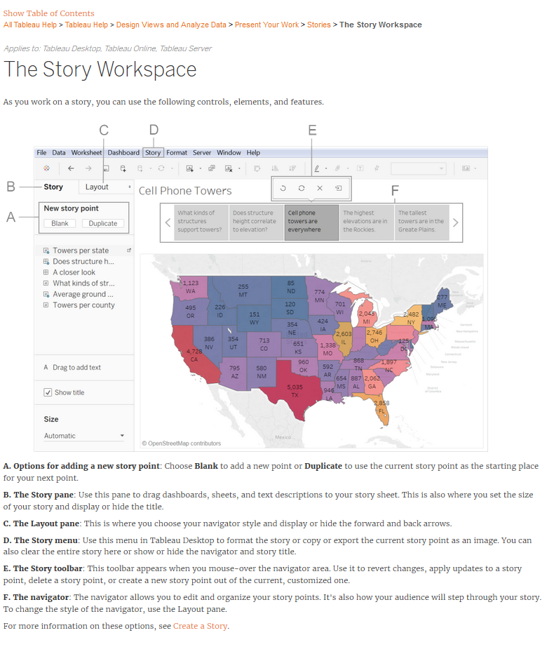
http://onlinehelp.tableau.com/current/pro/desktop/en-us/story_workspace.html

Slide 22
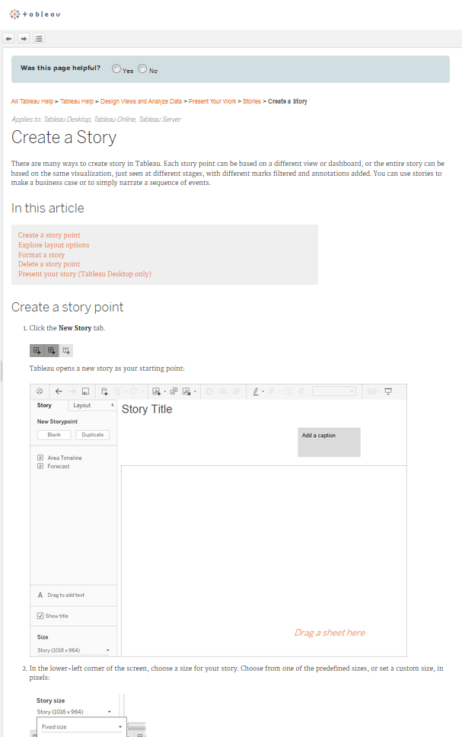
http://onlinehelp.tableau.com/current/pro/desktop/en-us/help.html#story_create.html

Slide 23
Additional Tableau Story Resources
Tips for Better Tableau Story Points
Tableau Research: An Argument Structure for Data Stories
Best Practices for Telling Stories
Types of stories

Slide 24
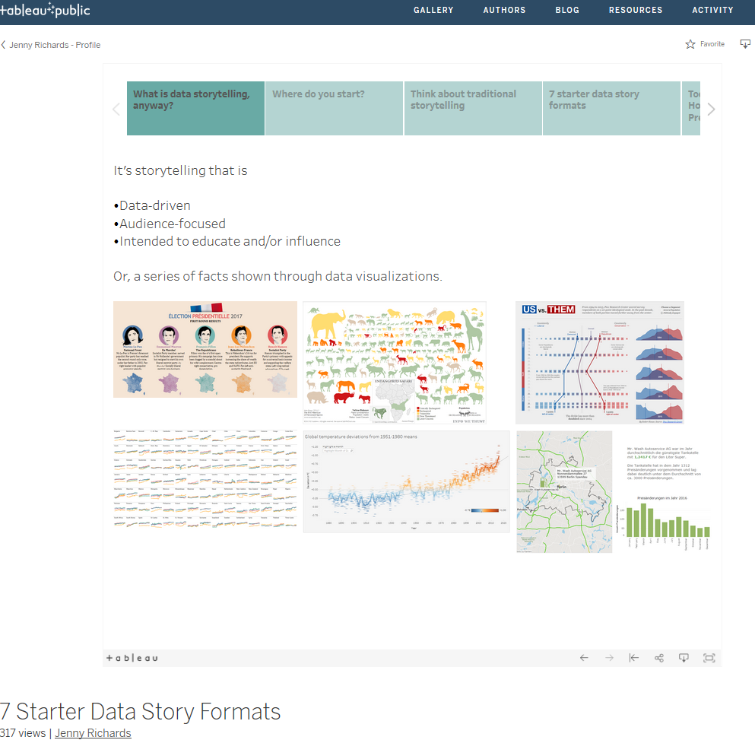
Walks through each type of data story….
IN A TABLEAU STORY!!
https://public.tableau.com/profile/jnnyrchrds#!/vizhome/7StarterDataStoryFormats/7DataStarterStoryTypes

